Slide 1
Advanced Node

Slide 2
NODE APPLICATION AS WINDOWS SERVICE

Slide 3
Node-windows
node-windows is a utility to run Node.js scripts as Windows services.
Creating a Windows services requires administrative privileges.
Can Create a Simple Script which deploy the script as windows service
npm install -g node-windows
In the project root, run:
npm link node-windows

Slide 4
Node-windows
  var Service = require('node-windows').Service;
  var svc = new Service({
  name:'Hello World',
  description: 'The nodejs.org example web server.',
  script: 'C:\\path\\to\\helloworld.js'
  });
  svc.on('install',function(){
  svc.start();
  });
  svc.install();

Slide 5
Node -Windows
The Service object emits the following events:
install
  Fired when the script is installed as a service.
alreadyinstalled
  Fired if the script is already known to be a service.
invalidinstallation
  Fired if an installation is detected but missing required files.
uninstall
  Fired when an uninstallation is complete.
Start
  Fired when the new service is started.
stop
  Fired when the service is stopped.
error
  Fired in some instances when an error occurs.

Slide 6
PACKAGING NODE APPLICATION

Slide 7
Packaging
Node applications are packaged as a self-contained bundle
It will have all of the artifacts and modules that might be required in order to deploy an application
Then “npm pack” and “npm install <Project>.tar.gz. Is used to deploy the Project.

Slide 8
Packaging
npm pack
Creates a file with .tgz extension
Move the generated file to the Production server
npm install XXX-1.0.0.tgz
This unzips the bundle into a 'node_modules' directory
Set Path to the Module and invoke the application
node index.js

Slide 9
NODEJS TESTING

Slide 10
Jasmine
Jasmine Module is installed through NPM .
  npm install jasmine -g
  npm install jasmine-node -g
jasmine init
  It creates a spec directory and configuration json
  The spec directory is used to store test files.
  The configuration file will be stored in the spec/support folder as jasmine.json.
  This file enumerates the source files and spec files for the Jasmine runner

Slide 11
Jasmine Test
quickStart.js
  exports.addNumber = function(a, b) {
  return a + b;
  };
add-spec.js
  var app = require("../quickStart.js");
  describe("Addition", function() {
  it("The function should add 2 numbers", function() {
  var value = app.addNumber(5, 6);
  expect(value).toBe(12);
  });
  });

Slide 12
Test Spec
  var calculator = require("../calculator");
  describe("multiplication", function () {
  it("should multiply 2 and 3", function () {
  var product = calculator.multiply(2, 3);
  expect(product).toBe(6); });
  });
  jasmine-node --autotest.
  jasmine-node --autotest --watch

Slide 13
Asynchronous Testing
npm install request –save
done() - callback
  Triggers the test to run asynchronously waiting until the done() called.
  var request = require('request');
  describe("Testing Async Operations", function() {
  it("should respond with hello world", function(done) {
  request("http://localhost:3000/hello", function(error, response, body) {
  expect(body).toEqual("hello world");
  done();
  });
  });
  });

Slide 14
CLUSTERING

Slide 15
Number of CPU
A system may contain multiple physical CPUs and can contain one or more cores or processors
A system that has 2 dual core CPUs would be 2 physical CPUs at 2 cores (dual core) for each CPU.
2 CPUs x 2 cores per CPU = 4 total cores

Slide 16
Clustering
Each Node.js process runs in a single thread and by default it has a memory limit
The memory and processing power can become bottlenecks for various processes.
Solution is to scale the applications I
  To split a single process into multiple processes or workers
Achieved through a cluster module.
Cluster allows to create child processes (workers), which share all the server ports with the main Node process (master).

Slide 17
Cluster Module
This module contains a set of functions and properties to fork processes to take advantage of multi-core systems.
It is a level of scalability in node application
  Higher levels like scaling vertically and horizontally in different machines are also possible.
Can create a parent/master process that can be forked in any number of child/worker processes and communicate with them sending messages
  There is no shared memory among processes.

Slide 18
Fork()
fork():
  Create a new node process, as we run it via command line with $node app.js
  It is like many processes running app.js
A child process is created and executed, it does the same as the master
imports the cluster module
Executes statement.
Child process ends running by invoking a function construct.
Need to explicitly terminate the master and worker processes

Slide 19
Parent –Child Process
Application Creates a master process that retrieves the number of CPUs and forks a worker process for each CPU
The worker processes are spawned using the child_process.fork() method
Each child process prints a message in console and exit.
  const cluster = require('cluster');
  const http = require('http');
  const numCPUs = require('os').cpus().length;
  if (cluster.isMaster) {
  masterProcess();
  } else {
  childProcess();
  }

Slide 20
Parent –Child Process
  function masterProcess() {
  console.log(`Master ${process.pid} is running`);
  for (let i = 0; i < numCPUs; i++) {
  console.log(`Forking process number ${i}...`);
  cluster.fork();
  }
  process.exit();
  }
  function childProcess() {
  console.log(`Worker ${process.pid} started and finished`);
  process.exit();
  }
Master 12568 is running
Forking process number 0...
Forking process number 1...
Forking process number 2...
Forking process number 3...
Worker 12548 started and finished

Slide 21
Cluster Events
A cluster module contains several events.
online
  Emitted when the worker is forked and sends the online message.
exit
  exit is emitted when a worker process dies
'message'
  Emitted whenever a message sent by a parent process
  using childprocess.send() is received by the child process.

Slide 22
Clustering Example
  var express=require("express");
  var app=express();
  app.get('/',function(req,res){
  res.end("Hello world !");
  });
  app.listen(3000,function(){
  console.log("Running at PORT 3000");
  });

Slide 23
Clustering Example
  var cluster = require('cluster');
  var numCPUs = require('os').cpus().length;
  if (cluster.isMaster) {
  for (var i = 0; i < numCPUs; i++) {
  cluster.fork();
  }
  cluster.on('exit', function(worker, code, signal) {
  console.log('worker ' + worker.process.pid + ' died');
  });
  } else {
  require("./app.js");
  }

Slide 24
Clustering Communication
  function masterProcess() {
  console.log(`Master ${process.pid} is running`);
  function show(message) {
  console.log(`Master ${process.pid} recevies message '${JSON.stringify(message)}' `);
  }
  for (let i = 0; i < numCPUs; i++) {
  console.log(`Forking process number ${i}...`);
  const worker = cluster.fork();
  workers.push(worker);
  worker.on('message', show);
  }
  workers.forEach(function(worker) {
  console.log(`Master ${process.pid} sends message to worker ${worker.process.pid}...`);
  worker.send({ msg: `Message from master ${process.pid}` });
  }, this);
  }

Slide 25
Clustering Communication
  function childProcess() {
  console.log(`Worker ${process.pid} started`);
  process.on('message', function(message) {
  console.log(`Worker ${process.pid} recevies message '${JSON.stringify(message)}'`);
  });
  console.log(`Worker ${process.pid} sends message to master...`);
  process.send({ msg: `Message from worker ${process.pid}` });
  console.log(`Worker ${process.pid} finished`);
  }

Slide 26
Child Process Module
Provides the ability to spawn child processes
This capability is provided by functions like spawn()
By default, pipes for stdin, stdout, and stderr are established between the parent Node.js process and the spawned child.
It is possible to stream data through these pipes in a non-blocking way.

Slide 27
Child Process Module
The Node.js child process module provides the ability to spawn child processes
Three ways to create child process:
child_process.exec()
  Runs a command in a console and buffers the output.
  child_process.exec(command[, options], callback)
child_process.spawn()
  Launches a new process with a given command.
child_process.fork()
  A special case of spawn() method to create child processes.

Slide 28
child_process.exec()
  const exec = require('child_process').exec;
  exec('my.bat', (err, stdout, stderr) => {
  if (err) {
  console.error(err);
  return;
  }
  console.log(stdout);
  });
  File: my.bat
  dir
  mkdir child
  node childProcess.js

Slide 29
Child Process Communication
  const cp = require('child_process');
  const n = cp.fork(`${__dirname}/sub.js`);
  n.on('message', (m) => { console.log('PARENT got message:', m); });
  n.send({ hello: 'world' });
  And then the child script, 'sub.js' might look like this:
  process.on('message', (m) => { console.log('CHILD got message:', m); });
  process.send({ info: ‘hi', name: ‘ramesh’ });

Slide 30
Debugging Node.js Apps
Many tools and libraries are available to help you debug your Node.js apps.
node-inspect
  Bundled with Node
  Invoked with node inspect myscript.js.
  Can also be installed independently with npm install -g node-inspect
  Invoked with node-inspect myscript.js.

Slide 31
Debugging Node.js Apps
Chrome DevTools
  Open chrome://inspect
  Click the "Open dedicated DevTools for Node" link.
  Install the Chrome Extension NIM (Node Inspector Manager):
VS Code
  In the Debug panel, click the settings icon to open
  Select "Node.js" for initial setup.
  Package.json
  "scripts": {
  "start": "set DEBUG=express:* & node ./bin/www"
  }

Slide 32
Debugging Node.js with Chrome DevTools
Run node with the --inspect flag:
node --inspect index.js
Open about:inspect in Chrome
  It’ll redirect you to chrome://inspect quickly
Click the Open dedicated DevTools for Node link.
  A popup window for debugging node session.
  The window will automatically reconnect to it.
  Complete breakpoint debugging, stepping
  Source maps for transpiled code

Slide 33
Debug With VSCode
Done by creating debugger configuration file ”launch.json” for your Express application.
Can use the Debug icon in the Activity Bar
Use the Configure gear icon to create a default launch.json file.
Select the Node.js environment by ensuring that the type property in configurations is set to "node".
  {
  "version": "0.2.0",
  "configurations": [
  { "type": "node", "request": "launch",
  "name": "Launch Program", "program": "${workspaceFolder}\\bin\\www" }
  ] }

Slide 34
SocketIO
Socket.io is used for real time communication between applications.
In chat application and some other applications you can use socket.io.
Communication between applications using socket.io is very speedy.
Socket.io is also used in IOT (Internet of things) for real time object status.
>> npm install socket.io

Slide 35
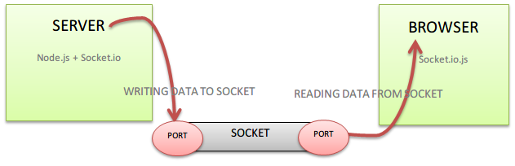
Socket IO

Slide 36
SocketIO
  var server = http.createServer(function(request, response) {});
  server.listen(8083);
  var listener = io.listen(server);
  listener.sockets.on('connection', function(socket) {
  socket.emit('msgWelcome’', { 'message': 'Hello User will come to Chat window !' });
  socket.on('socket_Data_1', function(data) {
  io.emit('message_1', data);
  });
  });

Slide 37
OAUTH2

Slide 38
Introduction
OAuth 2 is an authorization framework that enables applications to obtain limited access to user accounts on an HTTP service, such as Facebook, GitHub
It works by delegating user authentication to the service that hosts the user account, and authorizing third-party applications to access the user account.
OAuth 2 provides authorization flows for web and desktop applications, and mobile devices.

Slide 39
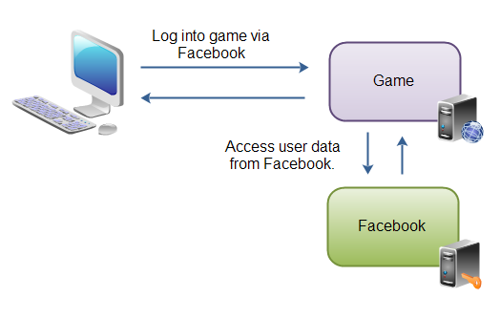
Introduction
The user accesses the game web application.
The game web application asks the user to login to the game via Facebook.
The user logs into Facebook, and is sent back to the game.
The game can now access the users data in Facebook, and call functions in Facebook on behalf of the user (e.g. posting status updates).

Slide 40
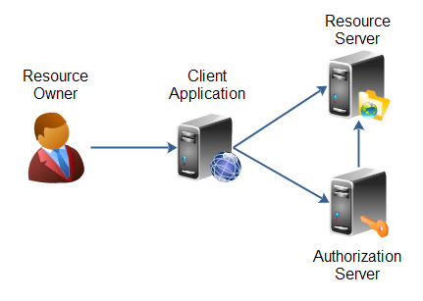
Roles

Slide 41
Roles
Resource owner
  The person or application that owns the data that is to be shared.
  A user on Facebook or Google could be a resource owner.
Resource
  They own is their data.
  The resource owner can be a person, or an application.
Resource server
  The server hosting the resources.
  Facebook or Google own s resource server
Client application
  Application requesting access to the resources stored on the resource server.
  The resources, which are owned by the resource owner.
  A client application could be a game requesting access to a users Facebook account.
Authorization server
  Server authorizing the client app to access the resources of the resource owner.
  The authorization server and the resource server can be the same server

Slide 42
Role of OAuth
OAuth is a framework to provide authorization functionality and not just authentication.
Fits the social network model very well.
Popular for social networks that want to allow third-party "plugins".
This is an area where access to the resources is inherently necessary and is also inherently unreliable
The Following may not be an Ideal use of Oauth:
  An online financial advice firm accessing our bank records automatically

Slide 43
Demo Code
https://brentertainment.com/oauth2/

